Slide 1
Chapter 4: GUI
Data and Classes

Slide 2
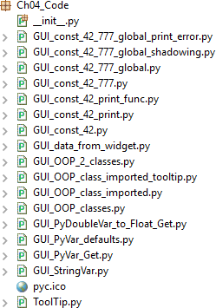
Data and Classes Chapter 4
Data and Classes
In this chapter, we will save our GUI data into tkinter variables. We will also start using object-oriented programming (OOP). This will lead us to creating reusable OOP components.
By the end of this chapter, you will know how to save data from the GUI into local tkinter variables. You will also learn how to display tooltips over widgets, which give the user additional information.

Slide 3
Data and Classes Chapter 4
Content
How to use StringVar()
How to get data from a widget
Using module-level global variables
How coding in classes can improve the GUI
Writing callback functions
Creating reusable GUI components

Slide 4
Data and Classes Chapter 4
1_How to use StringVar()
There are built-in programming types in tkinter that differ slightly from the Python types we are used to programming with. StringVar() is one such tkinter type.
Getting ready
In this recipe, you will learn how to save data from the tkinter GUI into variables so we can use that data. We can set and get their values, which is very similar to how you would use the Java getter/setter methods.

Slide 5

Data and Classes Chapter 4
Here are some of the types of code in tkinter:
strVar = StringVar() | Holds a string; the default value is an empty string ("")
intVar = IntVar() | Holds an integer; the default value is 0
dbVar = DoubleVar() | Holds a float; the default value is 0.0
blVar = BooleanVar() | Holds a Boolean, it returns 0 for False and 1 for True
Different languages call numbers with decimal points float or double. tkinter calls them DoubleVar, which is known in Python as the float data type. Depending on the level of precision, float and double data can be different. Here, we are translating DoubleVar of tkinter into a Python float type.

Slide 6
Data and Classes Chapter 4
How to do it…
We will create a DoubleVar of tkinter variable and add a float number literal to it using the + operator. After that, we will look at the resulting Python type.
Here are the steps to see the different tkinter data types:
Create a new Python module and name it GUI_PyDoubleVar_to_Float_Get.py.
At the top of the GUI_PyDoubleVar_to_Float_Get.py module, import tkinter:
import tkinter as tk

Slide 7
Data and Classes Chapter 4
3.Create an instance of the tkinter class:
win = tk.Tk()
Create a DoubleVar and give it a value:
doubleData = tk.DoubleVar() print(doubleData.get()) doubleData.set(2.4) print(type(doubleData))
add_doubles = 1.222222222222222222222222 + doubleData.get() print(add_doubles)
print(type(add_doubles))

Slide 8
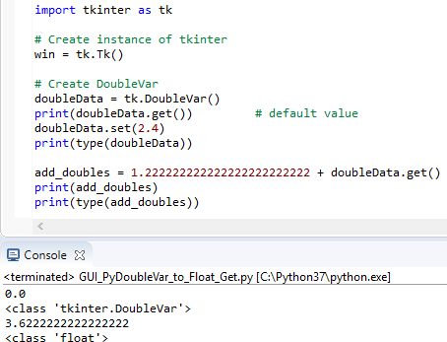
Data and Classes Chapter 4
5. The following screenshot shows the final GUI_PyDoubleVar_to_Float_Get.py code:

Slide 9
Data and Classes Chapter 4
We can do the same with tkinter with regards to strings.
We will create a new Python module as follows:
Create a new Python module and name it GUI_StringVar.py.
At the top of the GUI_StringVar.py module, import tkinter:
import tkinter as tk
Create an instance of the tkinter class:
win = tk.Tk()

Slide 10
Data and Classes
Chapter 4
Assign a StringVar of tkinter to the strData variable:
strData = tk.StringVar()
Set the strData variable:
strData.set('Hello StringVar')
Get the value of the strData variable and save it in varData:
varData = strData.get()
Print out the current value of strData:
print(varData)

Slide 11
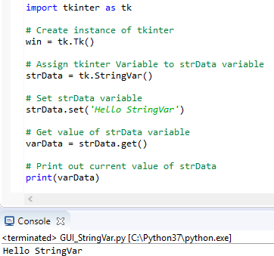
Data and Classes
Chapter 4
The following screenshot shows the final GUI_StringVar.py code and the output after running the code:

Slide 12
Data and Classes Chapter 4
Next, we will print the default values of, IntVar, DoubleVar, and BooleanVar types of tkinter:
Open GUI_StringVar.py and save the module as GUI_PyVar_defaults.py.
Add the following lines of code toward the bottom of this module:
print(tk.IntVar())
print(tk.DoubleVar())
print(tk.BooleanVar())

Slide 13
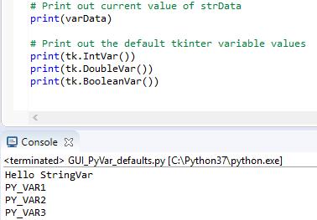
Data and Classes Chapter 4
The following screenshot shows the final GUI_PyVar_defaults.py code and the output after running the GUI_PyVar_defaults.py code file:

Slide 14
Data and Classes
Chapter 4
The steps to print the default tkinter variable value are as follows:
Create a new Python module and name it GUI_PyVar_Get.py.
Type the following code into the module:
import tkinter as tk
# Create instance of tkinter win = tk.Tk()
# Print out the default tkinter variable values intData = tk.IntVar()
print(intData) print(intData.get())
# Set a breakpoint here to see the values in the debugger
print()

Slide 15
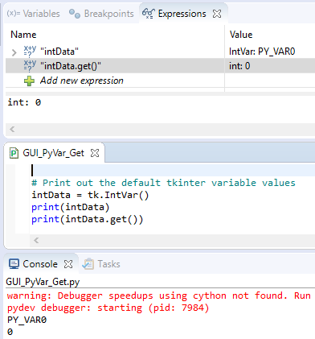
Data and Classes
Chapter 4
3. Run the code, optionally setting a breakpoint in your IDE in the final print() statement:

Slide 16
Data and Classes Chapter 4
2_ How to get data from a widget
When the user enters data, we want to do something with it in our code. This recipe shows how to capture data in a variable. In the previous recipe, we created several tkinter class variables. They were standalone. Now, we are connecting them to our GUI, using the data we get from the GUI, and storing them in Python variables.
Getting ready
We will continue using the Python GUI we were building in Chapter 3, Look and Feel Customization. We'll reuse and enhance the code from GUI_progressbar.py from that chapter.

Slide 17
Data and Classes Chapter 4
How to do it…
We will assign a value from our GUI to a Python variable:
Open GUI_progressbar.py from Chapter 3, Look and Feel Customization, and save the module as GUI_data_from_widget.py.
Add the following code toward the bottom of our module. Just above the main event loop, add strData:
strData = spin.get() print("Spinbox value: " + strData)

Slide 18
Data and Classes Chapter 4
Add code to place the cursor into the name entry:
name_entered.focus()
Start the GUI:
win.mainloop()

Slide 19
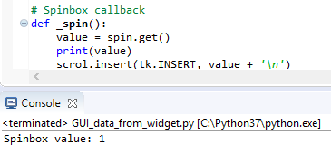
Data and Classes
Chapter 4
Running the code gives us the following result:

Slide 20
Data and Classes
Chapter 4
We will retrieve the current value of the Spinbox control:
We create our Spinbox widget using the following code, hard-coding the available values into it:
# Adding a Spinbox widget using a set of values
spin = Spinbox(mighty, values=(1, 2, 4, 42, 100), width=5, bd=8, command=_spin)
spin.grid(column=0, row=2)

Slide 21
Data and Classes
Chapter 4
We can also move the hard-coding of the data out of the creation of the Spinbox class instance and set it later:
# Adding a Spinbox widget assigning values after creation spin = Spinbox(mighty, width=5, bd=8, command=_spin) spin['values'] = (1, 2, 4, 42, 100)
spin.grid(column=0, row=2)
NOTE:
In order to get the values out of our GUI written using tkinter, we use the get() method of tkinter

Slide 22
Data and Classes
Chapter 4
3_ Using module-level global variables
Encapsulation is a major strength in any programming language, enabling us to program using OOP.
Because as we add more and more functionality to our GUI, we want to avoid naming conflicts that could result in bugs in our code.
Getting ready
We can declare module-level globals in any module just above and outside functions.
We then have to use the global Python keyword to refer to them. If we forget to use global in functions, we will accidentally create new local variables.

Slide 23
Data and Classes Chapter 4
How to do it…
Add the following code to the GUI we used in the previous recipe, How to get data from a widget, creating a module-level global variable. We use the all-uppercase convention for constants:
You can find more information in PEP 8 -- Style Guide for Python Code at https://www.python.org/dev/peps/pep-0008/#constants.

Slide 24
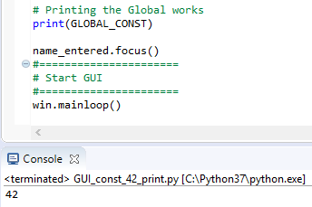
Data and Classes Chapter 4
Open GUI_data_from_widget.py and save the module as GUI_const_42_print.py.
Add the constant variable at the top and the print statement at the bottom of the module:
GLOBAL_CONST = 42 # ...
print(GLOBAL_CONST)
Running the code results in a printout of the global.

Slide 25
Data and Classes
Chapter 4
Add the usingGlobal function toward the bottom of the module:
Open GUI_const_42_print.py and save the module as GUI_const_42_print_func.py.
Add the function and then call it:
def usingGlobal(): print(GLOBAL_CONST)
# call the function usingGlobal()

Slide 26
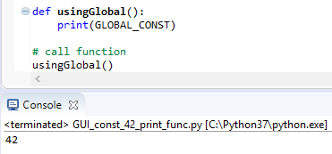
Data and Classes
Chapter 4
The following screenshot shows the final GUI_const_42_print_func.py code and the output after running the code:

Slide 27
Data and Classes
Chapter 4
In the preceding code snippet, we use the module-level global. It is easy to make a mistake by shadowing the global, as demonstrated in the following code:
Open GUI_const_42_print_func.py and save the module as GUI_const_42_777.py.
Add the declaration of the constant within the function:
def usingGlobal(): GLOBAL_CONST = 777
print(GLOBAL_CONST)

Slide 28
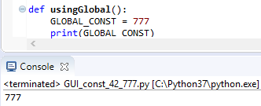
Data and Classes
Chapter 4
The following screenshot shows the final GUI_const_42_777.py code and the output after running the code:

Slide 29
Data and Classes Chapter 4
If we try to print out the value of the global variable, without using the global keyword, we get an error:
Open GUI_const_42_777.py and save the module as GUI_const_42_777_global_print_error.py.
Comment out global and try to print:
def usingGlobal():
# global GLOBAL_CONST print(GLOBAL_CONST) GLOBAL_CONST = 777
print(GLOBAL_CONST)

Slide 30

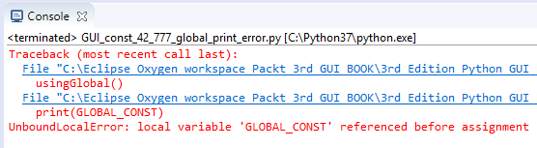
Data and Classes Chapter 4
Run the code and observe the output:

Slide 31
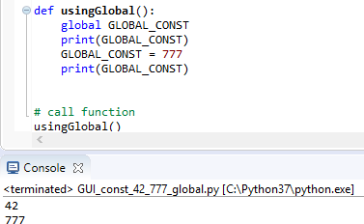
Data and Classes Chapter 4
When we qualify our local variable with the global keyword, we can print out the value of the global variable and overwrite this value locally:
Open GUI_const_42_777_global.py.
Add the following code:
def usingGlobal():
global GLOBAL_CONST print(GLOVAL_CONST) GLOBAL_CONST = 777
print(GLOBAL_CONST)
Run the code and observe the output:

Slide 32
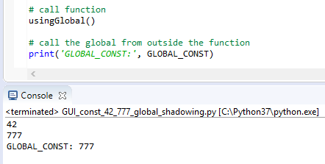
Data and Classes Chapter 4
We might believe that the value of the global variable is local to our function.
Open GUI_const_42_777_global.py and save as GUI_const_42_777_global_shadowing.py.
Add print('GLOBAL_CONST:', GLOBAL_CONST) below the function.
3. Run the code and observe the output:

Slide 33
4_ How coding in classes can improve the GUI
Data and Classes Chapter 4
So far, we have been coding in a procedural style. When our code gets larger and larger, we need to advance to coding in OOP.
Why?
Because, OOP allows us to move code around by using methods. Once we use classes, we no longer have to physically place the code above the code that calls it. This gives us great flexibility in organizing our code. We can write the related code next to the other code and no longer have to worry that the code will not run because the code does not sit above the code that calls it.
If the methods we call have not been created by that time, we get a runtime error.

Slide 34
Data and Classes Chapter 4
Getting ready
We will turn our entire procedural code into OOP very simply. We just turn it into a class, indent all the existing code, and prepend self to all variables.
It is very easy.
While at first it might feel a little bit annoying having to prepend everything with the self keyword, making our code more verbose (hey, we are wasting so much paper…), in the end it is worth it.

Slide 35
Data and Classes Chapter 4
How to do it…
Note that in the Eclipse IDE, the PyDev editor hints at coding problems by highlighting them in red on the right-hand side portion of the code editor.
Open GUI_const_42_777_global.py and save the module as GUI_OOP_classes.py.
Highlight the entire code below the imports and indent it by four spaces.
Add class OOP(): above the indented code.

Slide 36
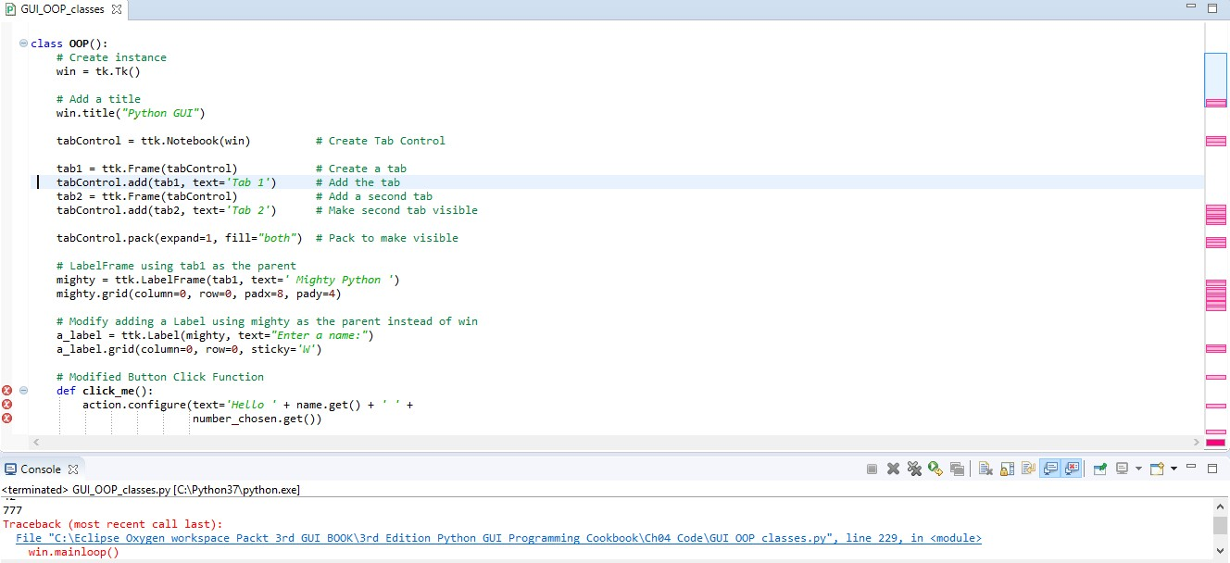
Data and Classes
Chapter 4
Look at all of the red errors in the code editor on the right-hand side:
We have to prepend all the variables with the self keyword and also bind the functions to the class by using self, which officially and technically turns the functions into methods.
Notes:
-Chúng ta phải thêm trước tất cả các biến với từ khóa self và cũng ràng buộc các hàm với lớp bằng cách sử dụng self, chính thức và kỹ thuật biến các hàm thành các phương thức.

Slide 37

Data and Classes
Chapter 4
Let's prefix everything with self to fix all of the red so we can run our code again:
Open GUI_OOP_classes.py and save the module as GUI_OOP_2_classes.py.
Add the self keyword wherever it is needed, for example, click_me(self).
Run the code and observe it:
Once we do this for all of the errors highlighted in red, we can run our Python code again. The click_me function is now bound to the class and has officially become a method. → no error

Slide 38
Data and Classes Chapter 4
Now let's add our ToolTip class from Chapter 3, Look and Feel Customization, into this Python module:
Open GUI_OOP_2_classes.py.
Add the ToolTip class from GUI_tooltip.py to the top of the following module's import statements:
class ToolTip(object):
def init (self, widget, tip_text=None): self.widget = widget
...
class OOP():
def init (self): self.win = tk.Tk()
ToolTip(self.win, 'Hello GUI')
# <-- use the ToolTip class here
...

Slide 39
Data and Classes Chapter 4
How it works…
We are translating our procedural code into object-oriented code. First, we indented the entire code and defined the code to be part of a class, which we named OOP. In order to make this work, we have to use the self keyword for both variables and methods.

Slide 40
Data and Classes Chapter 4
Here is a brief comparison of our previous code with the new OOP code using a class:
# Our procedural code looked like this:
# Button Click Function
def click_me():
action.configure(text='Hello ' + name.get() + ' ' +number_chosen.get())
# Adding a Textbox Entry widget
name = tk.StringVar()
name_entered = ttk.Entry(mighty, width=12, textvariable=name)
name_entered.grid(column=0, row=1, sticky='W')

Slide 41
Data and Classes Chapter 4
# Adding a Button
action = ttk.Button(mighty, text="Click Me!", command=click_me)
action.grid(column=2, row=1)
ttk.Label(mighty, text="Choose a number:").grid(column=1, row=0)
number = tk.StringVar()
number_chosen = ttk.Combobox(mighty, width=12, textvariable=number, state='readonly') number_chosen['values'] = (1, 2, 4, 42, 100)
number_chosen.grid(column=1, row=1)
number_chosen.current(0)
# ...

Slide 42
Data and Classes
Chapter 4
************************************* The new OOP code looks like this:
************************************* class OOP():
def init (self):
# Create instance
self.win = tk.Tk()
ToolTip(self.win, 'Hello GUI')
# Add a title
self.win.title("Python GUI")
self.create_widgets()
# Initializer method
# notice the self keyword
# Button callback
def click_me(self):
self.action.configure(text='Hello ' + self.name.get() + ' ' +self.number_chosen.get())
# ... more callback methods

Slide 43
Data and Classes
Chapter 4
def create_widgets(self):
# Create Tab Control
tabControl = ttk.Notebook(self.win)
tab1 = ttk.Frame(tabControl)
tabControl.add(tab1, text='Tab 1')
tab2 = ttk.Frame(tabControl)
tabControl.add(tab2, text='Tab 2')
# Pack to make visible
tabControl.pack(expand=1, fill="both")
# Create a tab
# Add the tab
# Create second tab
# Add second tab
# Adding a Textbox Entry widget - using self
self.name = tk.StringVar()
name_entered = ttk.Entry(mighty, width=12, textvariable=self.name) name_entered.grid(column=0, row=1, sticky='W')

Slide 44
Data and Classes
Chapter 4
# Adding a Button - using self
self.action = ttk.Button(mighty, text="Click Me!", command=self.click_me)
self.action.grid(column=2, row=1) # ...
#======================
# Start GUI
#======================
oop = OOP()
oop.win.mainloop()
# create an instance of the class
# use instance variable to call mainloop via oop.win

Slide 45

Data and Classes
Chapter 4
We moved all the widget-creation code into one rather long method, create_widgets, which we call in the initializer of the class.
Instead, in addition to a real constructor, Python provides us with an initializer, __init__(self). We are strongly encouraged to use this initializer. We can use it to pass in arguments to our class, initializing variables we wish to use inside our class instance.
In the end, we added the ToolTip class to the top of our module just below the import statements.
In Python, several classes can exist within the same Python module and the module name does not have to be the same as the class name.

Slide 46
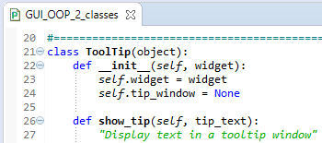
Data and Classes
Chapter 4
Here, in this recipe, we can see that more than one class can live in the same Python module.
Cool stuff, indeed! Here are two screenshots of the two classes residing in the same module:

Slide 47
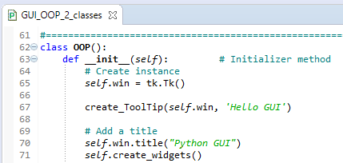
Data and Classes
Chapter 4
Both the ToolTip class and the OOP class reside within the same Python module, GUI_OOP_2_classes.py:
In this recipe, we advanced our procedural code into OOP code.

Slide 48
Data and Classes
Chapter 4
5_ Writing callback functions
The event handler is a callback function (or method, if we use classes). The callback method is also sitting there passively, like our GUI, waiting to be invoked. Once our GUI's button is clicked, it will invoke the callback.

Slide 49
Data and Classes
Chapter 4
Getting ready
The Python interpreter runs through all the code in a module once, finding any syntax errors and pointing them out. You cannot run your Python code if you do not have the syntax right. This includes indentation (if not resulting in a syntax error, incorrect indentation usually results in a bug).
At runtime, many GUI events can be generated, and it is usually callback functions that add functionality to GUI widgets.

Slide 50
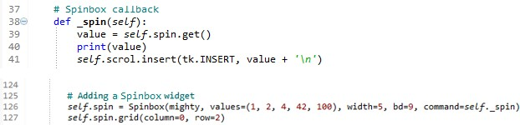
Data and Classes Chapter 4
How to do it…
Here is the callback for the Spinbox widget:
Open GUI_OOP_2_classes.py.
Observe the _spin(self) method in the code:

Slide 51

Data and Classes Chapter 4
How it works…
We create a callback method in the OOP class that gets called when we select a value from the Spinbox widget because we bind the method to the widget via the command argument (command=self._spin). We use a leading underscore to hint at the fact that this method is meant to be respected like a private Java method.

Slide 52
Data and Classes Chapter 4
6_ Creating reusable GUI components
We will create reusable GUI components using Python. In this recipe, we will keep it simple by moving our ToolTip class into its own module. Then, we will import and use it to display tooltips over several widgets of our GUI.
Getting ready
We are building our code from Chapter 3, Look and Feel Customization: GUI_tooltip.py. We will start by breaking out our ToolTip class into a separate Python module.

Slide 53
How to do it…
Data and Classes Chapter 4
We will create a new Python module and place the ToolTip class code into it and then import this module into our primary module:
Open GUI_OOP_2_classes.py and save the module as
GUI_OOP_class_imported_tooltip.py.
Break out the ToolTip code from GUI_tooltip.py into a new Python module and name the module ToolTip.py.
Import the ToolTip class into GUI_OOP_class_imported_tooltip.py:
from Ch04_Code.ToolTip import ToolTip

Slide 54
Data and Classes Chapter 4
Add the following code to GUI_OOP_class_imported_tooltip.py:
ToolTip(self.win, 'Hello GUI')
# Add a ToolTip to the Spinbox
ToolTip(self.spin, 'This is a Spinbox control')
# Add tooltips to more widgets
ToolTip(self.name_entered, 'This is an Entry control')
ToolTip(self.action, 'This is a Button control')
ToolTip(self.scrol, 'This is a ScrolledText control')
# Tab 2
ToolTip(curRad, 'This is a Radiobutton control')

Slide 55
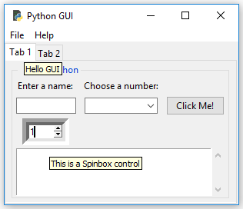
Data and Classes Chapter 4
Run the code and hover the mouse over the different widgets:

Slide 56
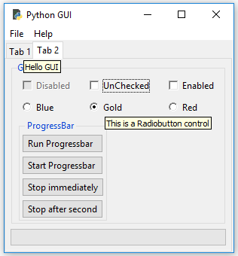
Data and Classes
Chapter 4
This also works on the second tab:

